Slide 1
Hydraulic Fracturing(Fracing)
Anjuli Gairola, John Silberstein, Danielle Torpy, Jasmine Wiley

Slide 2
Introduction
Fracing is injecting sand, water, or chemicals with high pressure underground via well – releasing trapped oil & gas
Concerns associated and so controversial
Area of interest for the project – In the year 2012 in Texas
Number of fracing wells
Top operators who opened the most wells
Location of the top three operators

Slide 3
Data visualization prep work
Dashboard
Streetmap with topography layers of fracing wells in Texas in 2012.
Barchart using plotly for top 13 operators that opened the most wells in 2012.
Streetmap with color coordinated markers for top three operators (Devon Energy, Pioneer Natural Resources, EOG Resources).

Slide 4
Data processing
Data was extracted from Fracdata
Downloaded in CSV format
Data transformed and uploaded in SQL database
Further data transformed to JSON for visualizations

Slide 5
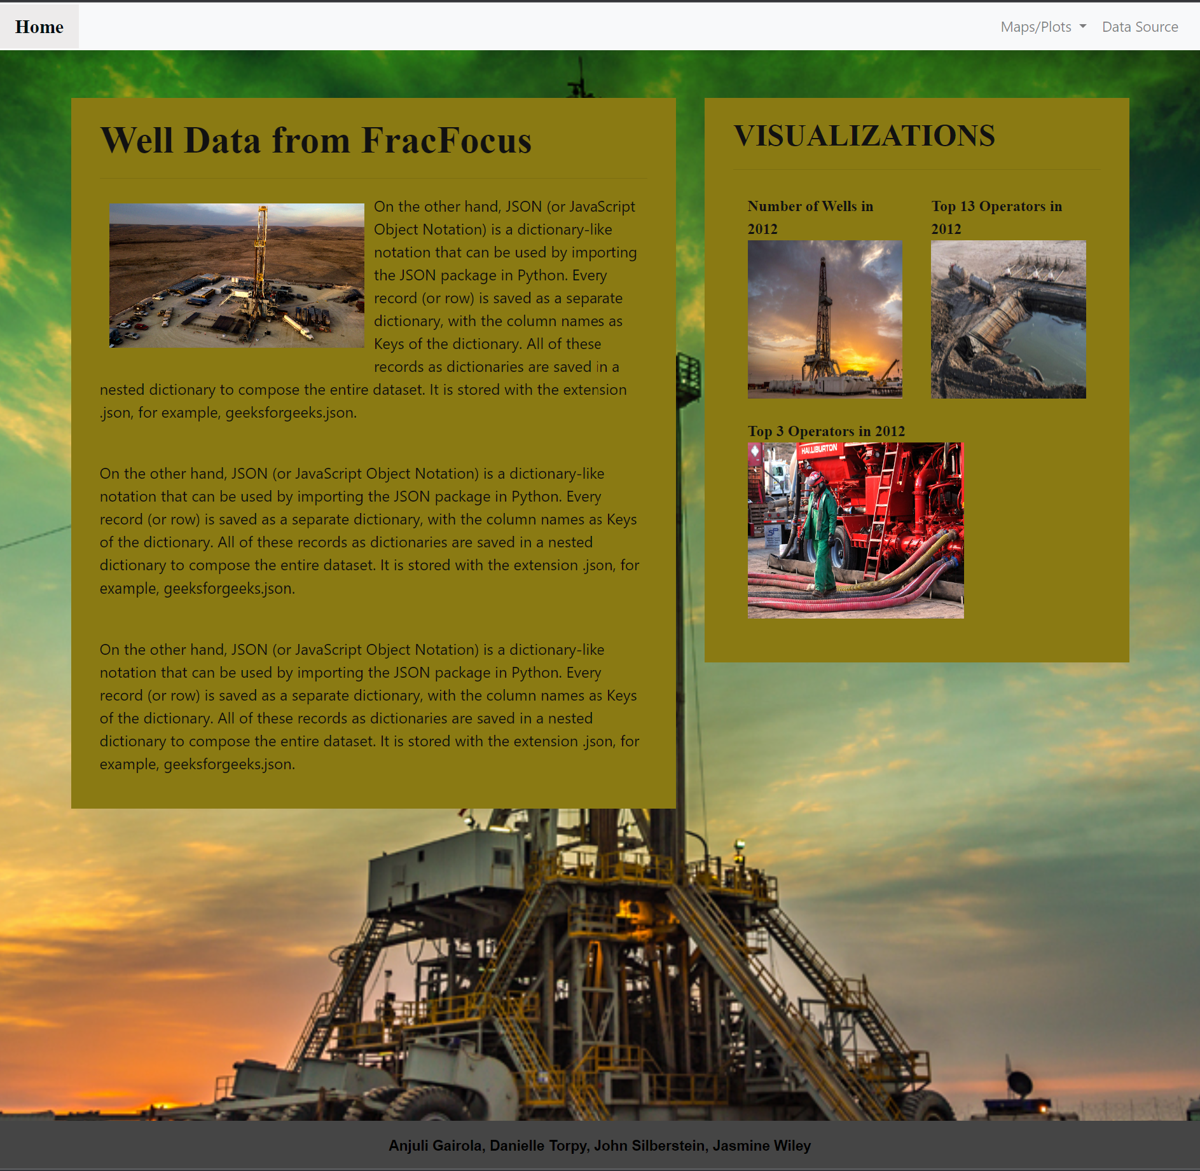
Home Page

Slide 6
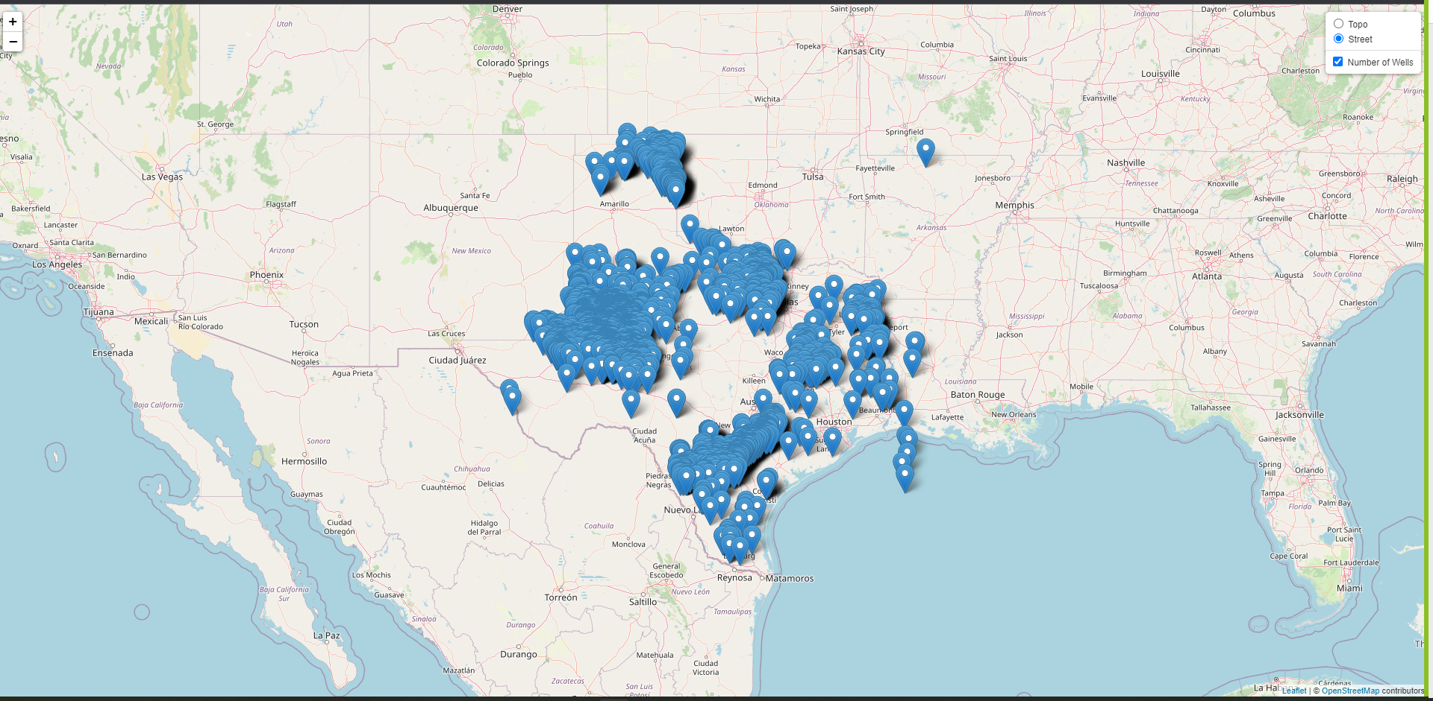
Visualization -1A Street view
Total number of fracing wells in Texas in 2012

Slide 7
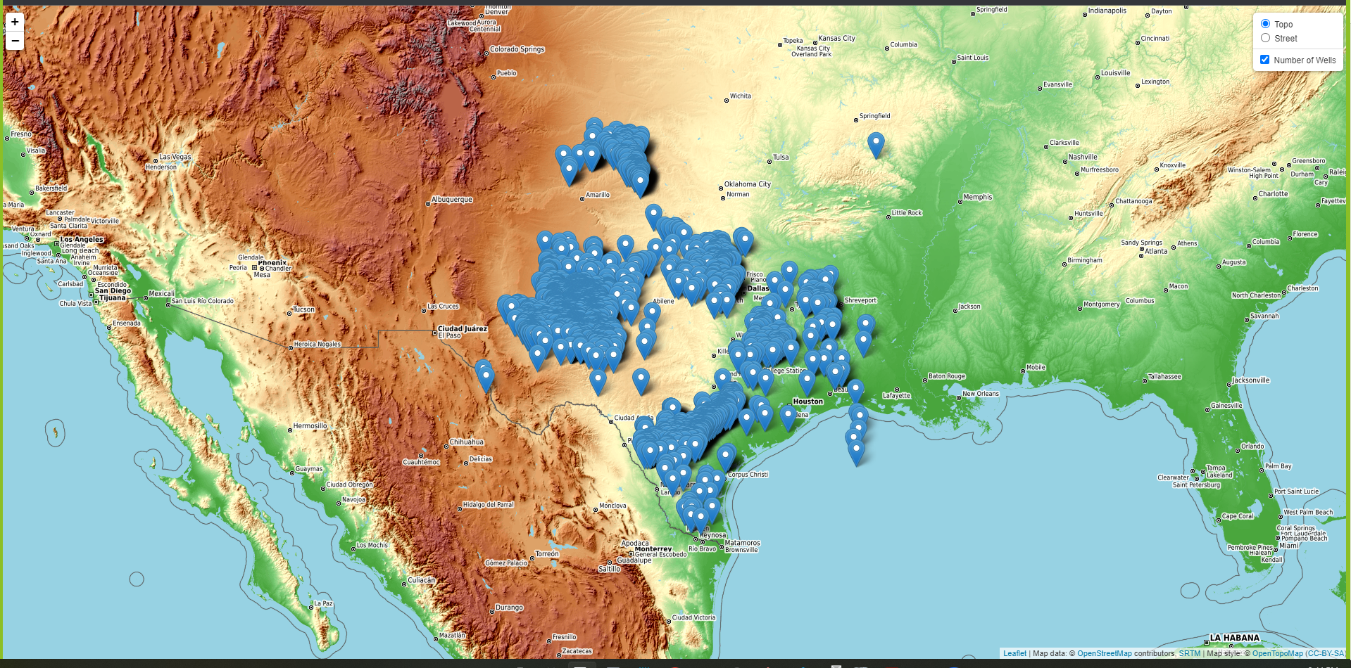
Visualization -1B Topographical view
Total number of fracing wells in Texas in 2012

Slide 8
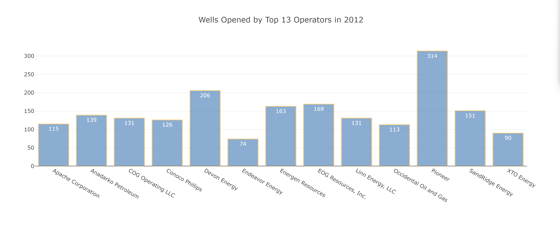
Visualization -2
The number of fracing wells opened by top 13 Operators in 2012 in Texas

Slide 9
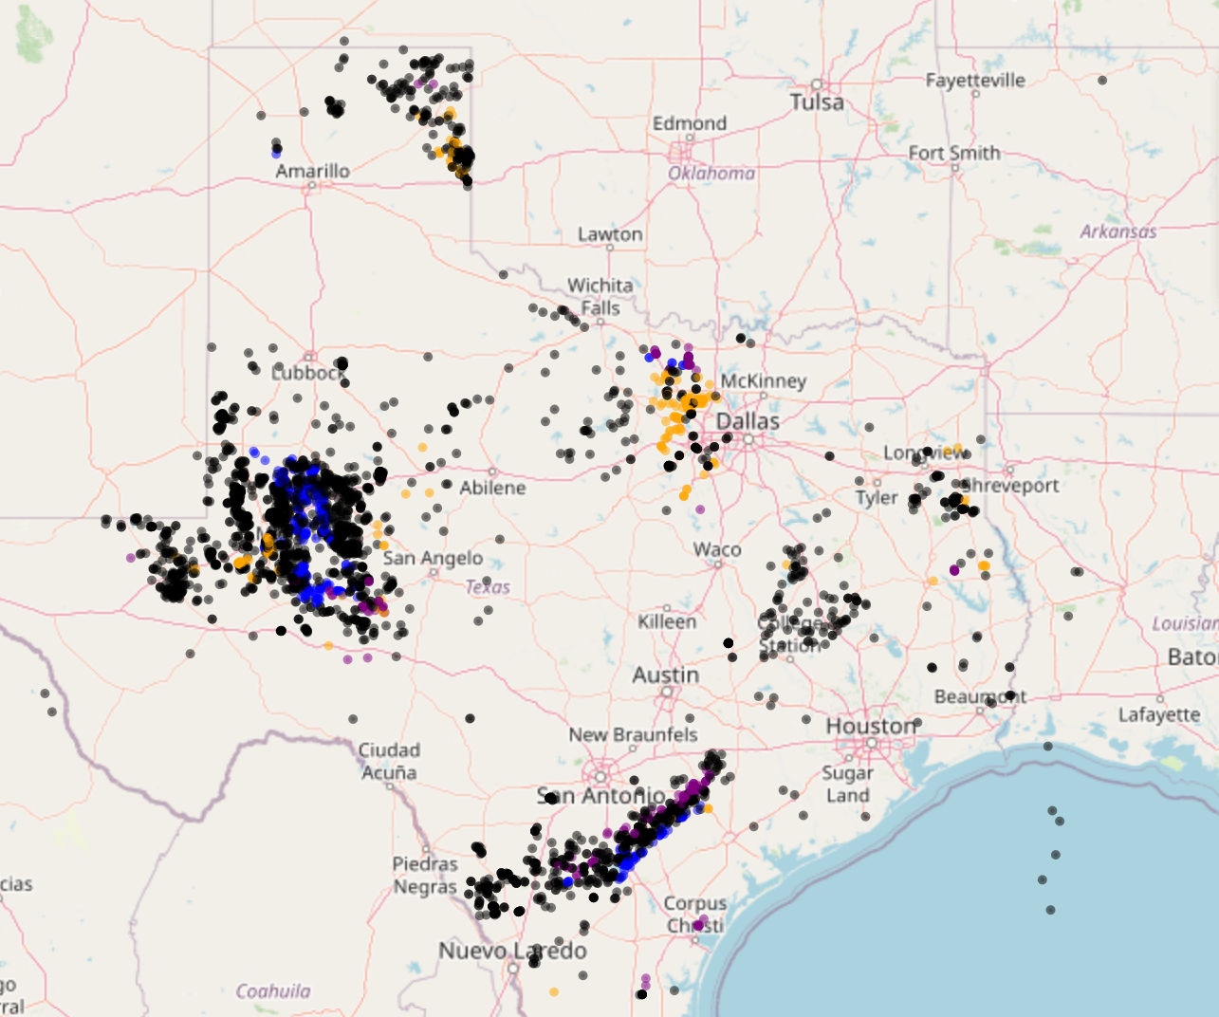
Visualization -3
Top 3 Operators in 2012
Legend
Pioneer Resources – Blue
Devon Energy – Orange
EOG Resources – Purple
Others - Black

Slide 10
Conclusions/future directions
Conclusions
In 2012, the total number of fracing wells was 3705 in Texas.
Pioneer was the top operator, with an opening of 314 wells, in 2012 in Texas.
Devon Energy and EOG Resources were second and third with 206 and 169 wells, respectively.
Future directions
Dashboard showing the change in the number of wells across years in various States.
Comparing the depth of wells.
Volume of water used for fracing.
Fracing and relationship with energy prices.
Health and environmental impact of fracing.

Slide 11
Thank you Questions Please

